Slide 1
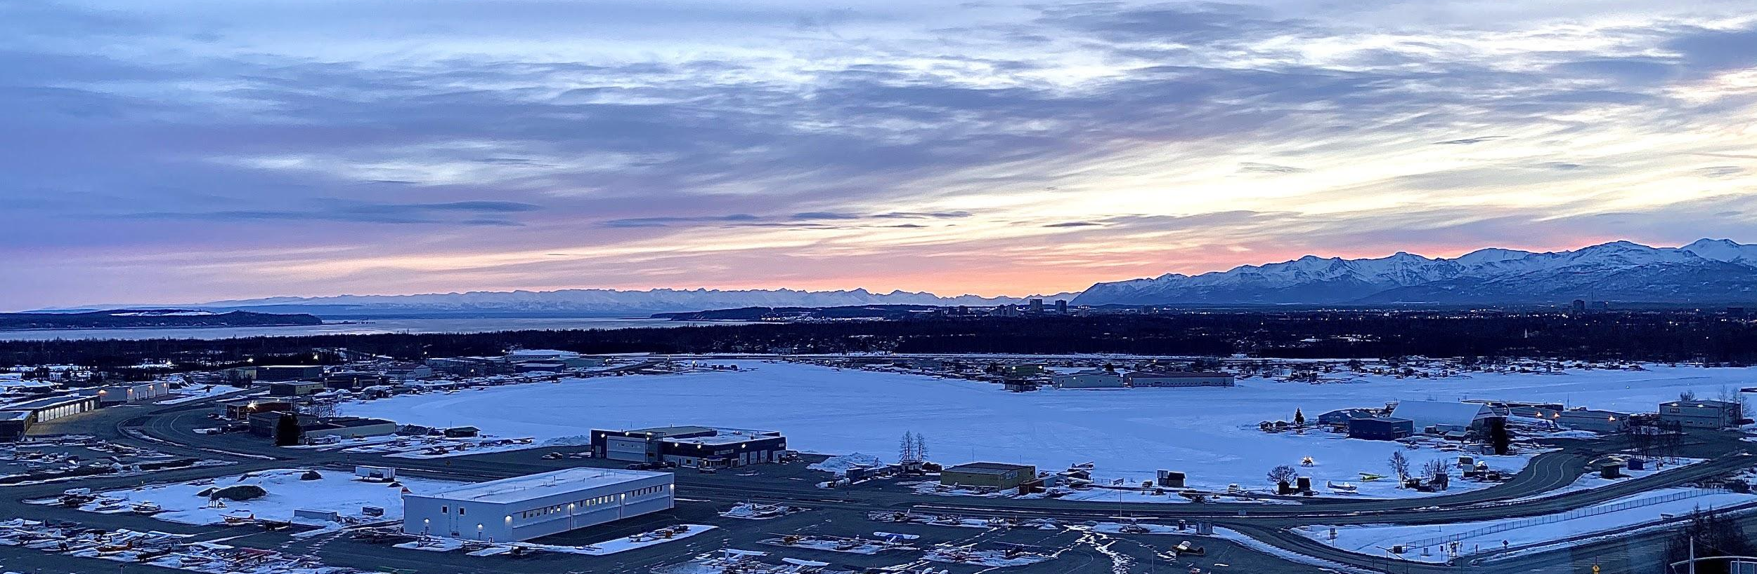
Lake Hood
Pilot Briefing
Presented by LHD Air Traffic Control Tower

Slide 2
Topics
Overview of Anchorage Airspace
VFR Routes to/from LHD and ANC
Helpful Tips
Part 93
VFR Flight Following
ADS-B Requirements
SVFR
Final Thoughts
Questions & Contact Info

Slide 3
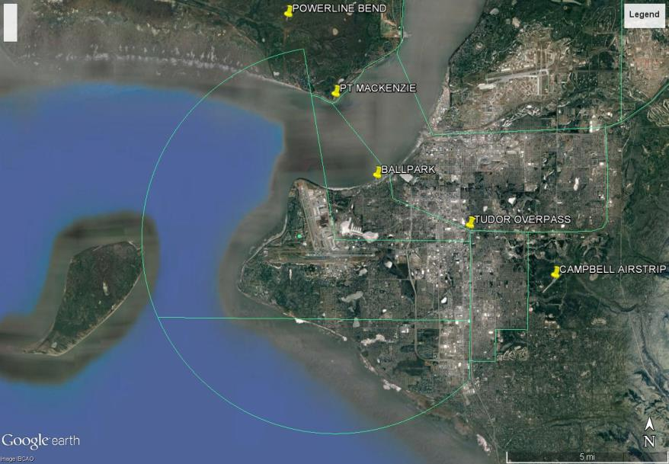
BOAT HULL
LHD and MRI airspace is divided at the middle of Pt. Mackenzie. Fly over the western part of Pt. Mackenzie.
SAND LAKE
CAMPBELL LAKE

Slide 4
Getting In & Out of ANC/LHD
WHO are you?
WHERE are you/where do you want to go?
WHAT surface do you want to land/depart on?
Do you have the ATIS?
ADDITIONAL REQUESTS (long landing, parking…)
All Lake Hood taxiways are uncontrolled, call ready at the runway in use.
* * *
Contact Lake Hood tower prior to taxiing on the lake.

Slide 5
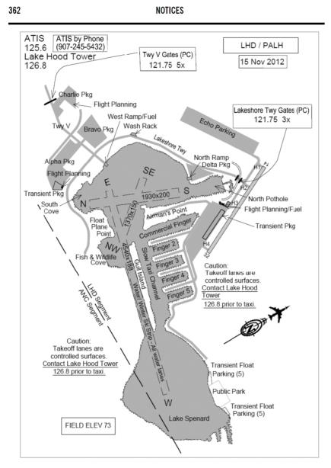
Lake Hood
Pictured above: “Cross the N/S channel abeam Airman’s Point.”
(Permission to cross the SE/NW water lane simultaneously is implied)
Pictured left: North Pothole and South Cove are considered part of the N/S channel safety area. Authorization required to enter.
Step taxiing is only allowed in the water lanes. Make your request with LHD tower.

Slide 6
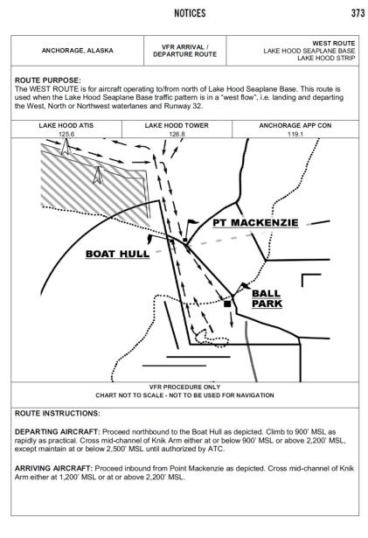
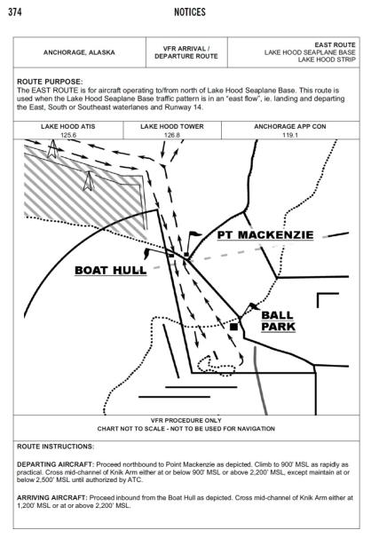

Slide 7
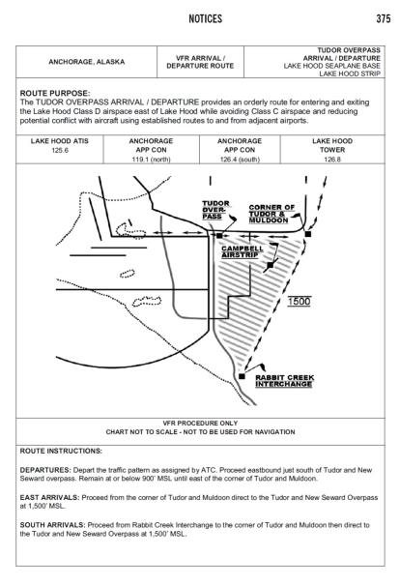
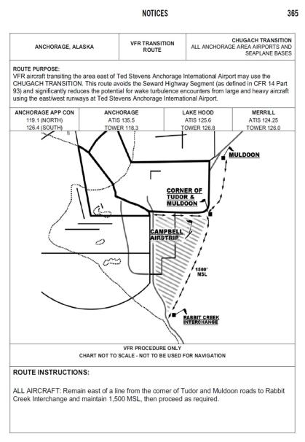

Slide 8
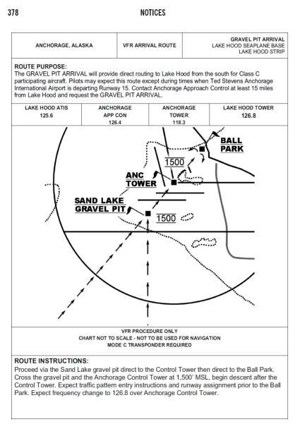
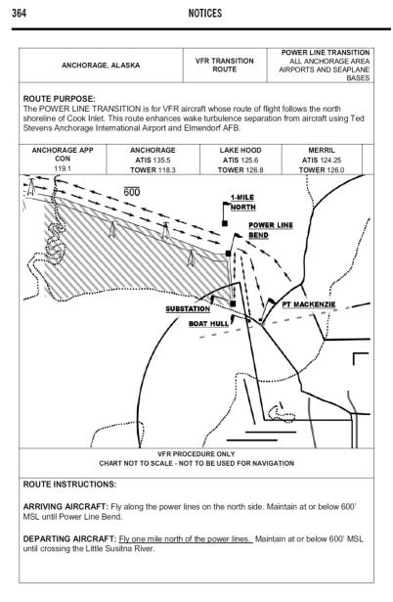

Slide 9
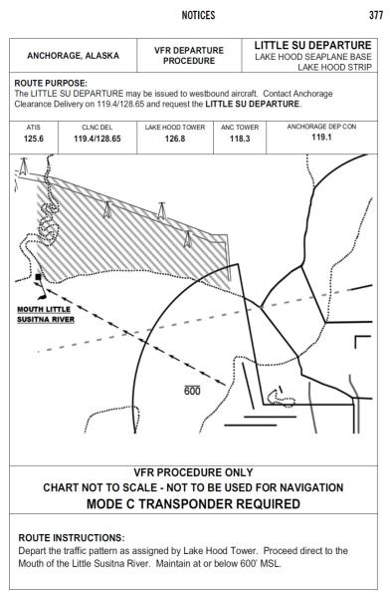
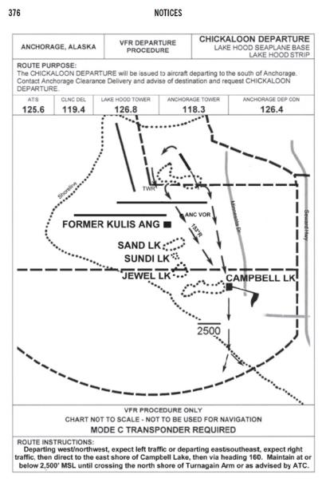
Little Su & Chickaloon Departure must be requested and are subject to traffic & workload at ANC.
ADS-B Required.
(See Slide 15)
Contact ANC Clearance Delivery for squawk.

Slide 10
Helpful Tips for Flying Routes
Routes & runways in use will be advertised on the ATIS. It is your responsibility to fly the advertised route.
When asked to report at a reporting point, report when over that point
  (With the proximity of operations at LHD, multiple aircraft may also be within a mile of that location)
It is not only important to fly the geographical route, but also the altitude
  (There is a small margin for error on the geographical routes in/out of LHD, the altitude separation helps to keep you separated from other aircraft on the route as well as MRI and ANC traffic)
  Try to familiarize yourself with routes before flying. If you are unfamiliar, advise LHD tower, we will help you!

Slide 11
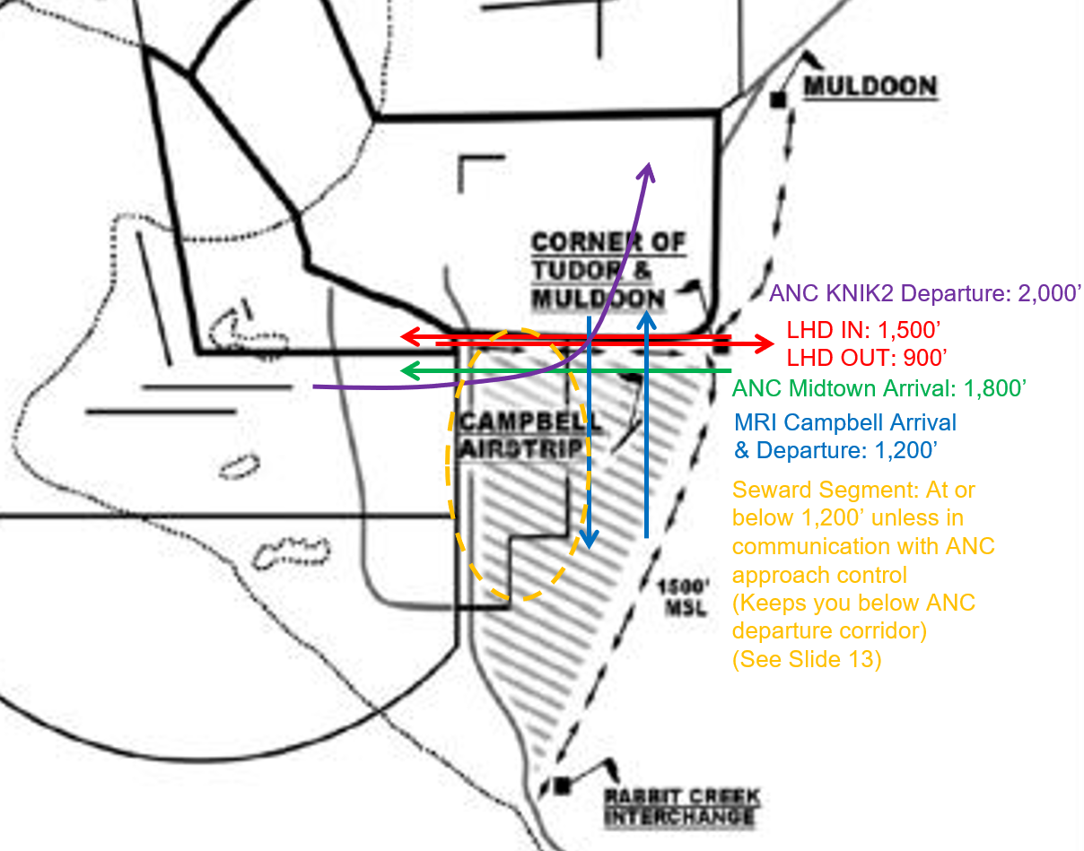
Importance of Altitude Compliance

Slide 12
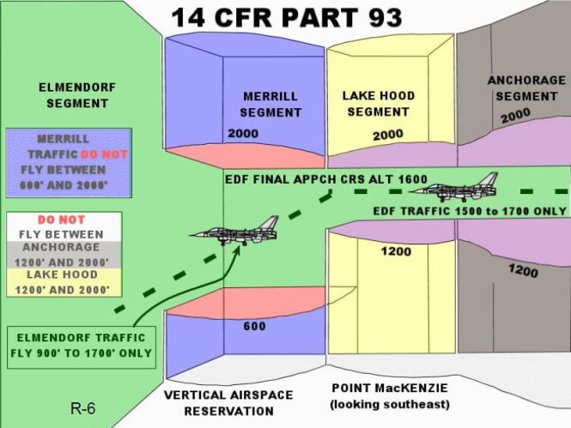
CFR 14 Part 93 – Knik Arm Altitude

Slide 13
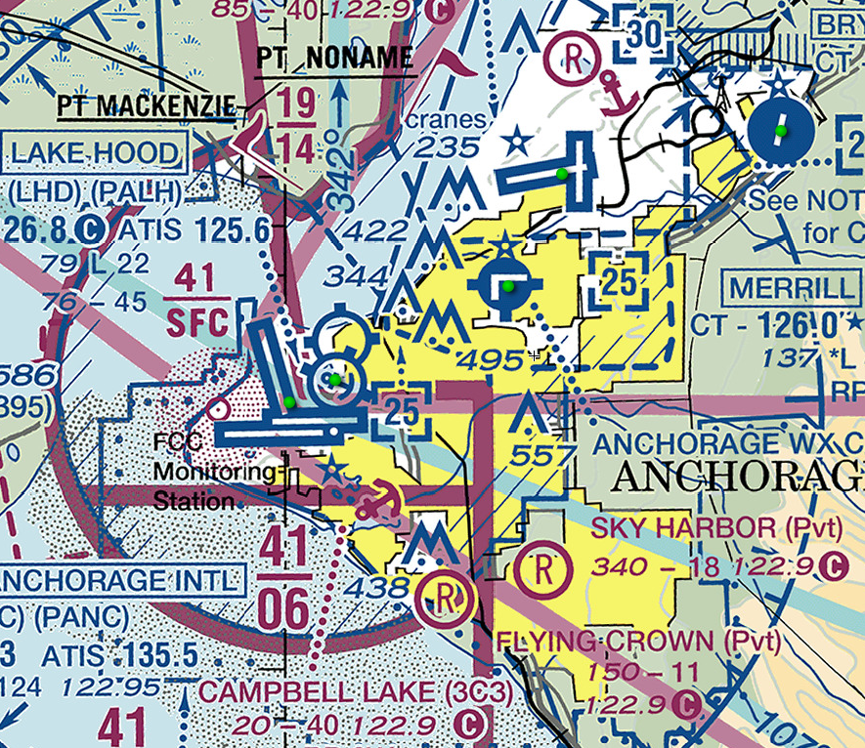
CFR 14 Part 93 – Seward Segment
Aircraft transitioning to/from Lake Hood or Merrill shall operate at or below 1200’ in the Seward Segment and be in communications with the respective tower
Any aircraft operating above 1200’ or not landing at Lake Hood or Merrill Field must contact approach control prior to entering the Seward Segment

Slide 14
VFR Flight Following
Advise on initial contact with Approach that you would like flight following to your destination
  Approach needs full call sign, aircraft type and destination
Contact Anchorage Clearance Delivery if you’re requesting flight following after departure
Filing a VFR flight plan with flight service does not imply flight following with Approach and Center, you must ask ATC
What squawk code you’re assigned doesn’t matter, flight following can be provided regardless of code
  Expect a code starting with 01 for local flight following, 12 for center
Transponder not required for flight following

Slide 15
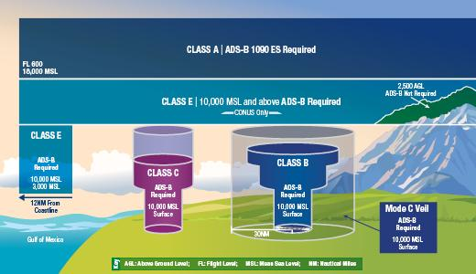
ADS-B
ADS-B required in and above ANC Class C Airspace. See below for deviation requests:
https://www.faa.gov/nextgen/equipadsb/
https://sapt.faa.gov/
Notes:
Not required in the LHD or MRI D airspace. Required above ANC Class C airspace (if climbing above part 93 restriction).

Slide 16
SVFR
What: A clearance for VFR aircraft to operate within class B, C, D or E surface areas in meteorological conditions below VMC.
ONLY AVAILABLE UPON PILOT REQUEST
Weather: Reported weather must be 1 SM or greater for departure or arrival into the surface area. Aircraft must remain clear of clouds.
  If ground visibility is not reported, 1 SM flight visibility may be used
Visual Separation: If you are entering/exiting the surface area with another aircraft, you must have them in sight and advise ATC you can maintain visual separation from that aircraft.
Priority: IFR aircraft and airborne SVFR aircraft have priority.
At a non-towered airport, ATC needs your down time

Slide 17
Final Thoughts
Use your call sign with each transmission (AIM 4-2-4)
Read back ATC issued instructions with your call sign
  While not all readbacks are required, it helps to ensure everyone is on the same page and prevent possible deviations and conflicts
Be extra vigilant for traffic in the vicinity of the powerline bend and along Tudor
Understand that LHD may be working ANC traffic as well, listen for YOUR call sign
Call early when inbound from the North to ensure contact is made with LHD tower before you enter the class D airspace
If you don’t understand an instruction, ask!
  Reach out to us with questions using the contact info on the next slide

Slide 18
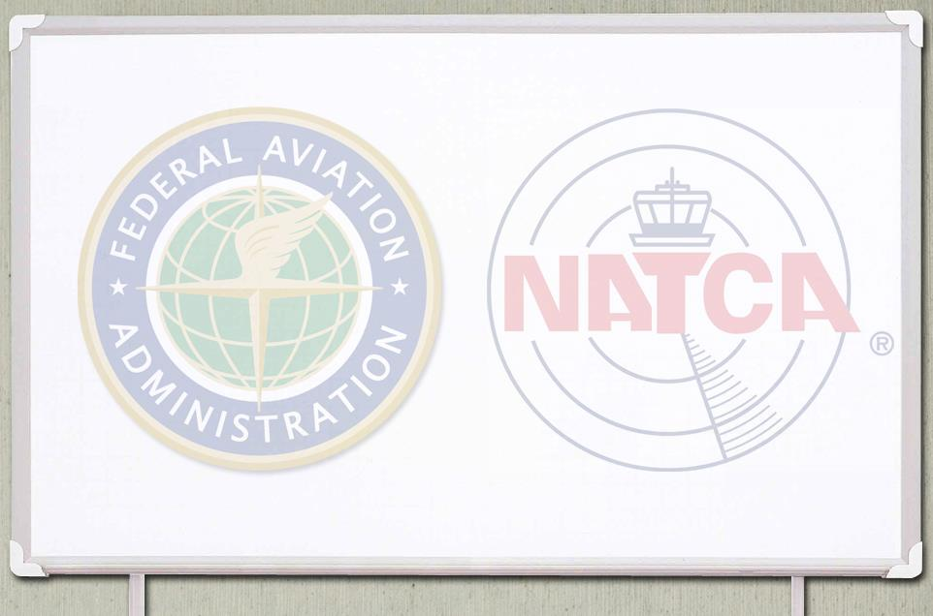
Contact Info
ANC/LHD Tower
(907) 271-6549
this is a recorded line
Clint Blaszak
(907) 242-2728
clinton.blaszak@faa.gov
ANC Approach
(907) 271-2711
this is a recorded line
Amanda Reimann
(907) 884-3262
areimann@natca.net
ancpilotoutreach@mail.com

